Slide 1
Improve Center Line Tutor by Deep Learning
Hejie Cui
Notes:
Well, good morning everyone. Very glad to have this chance to make a summary of my project for the nearly 2 month.

Slide 2
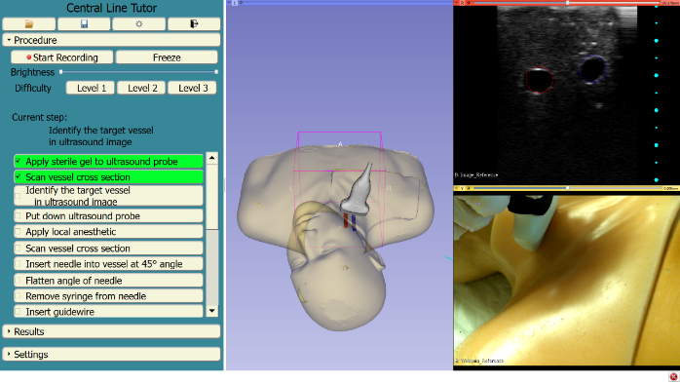
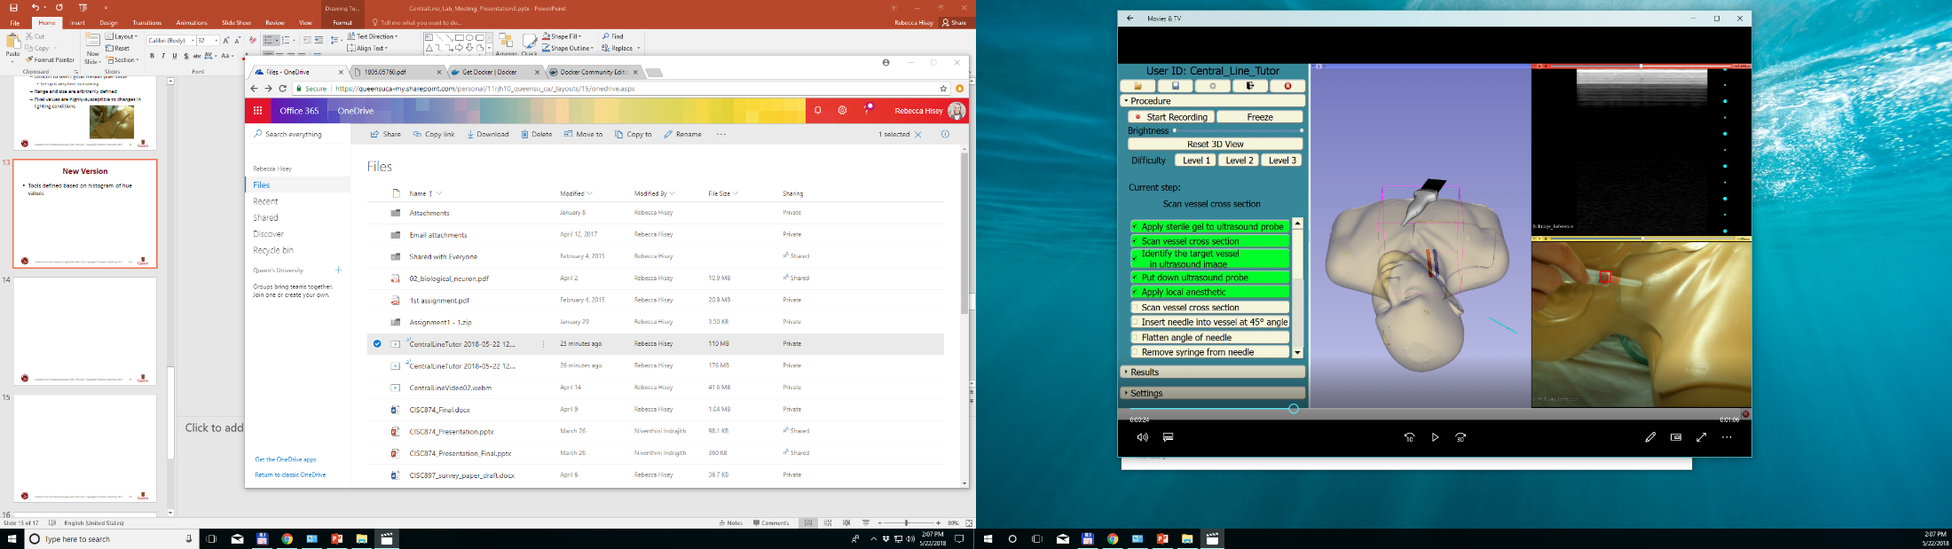
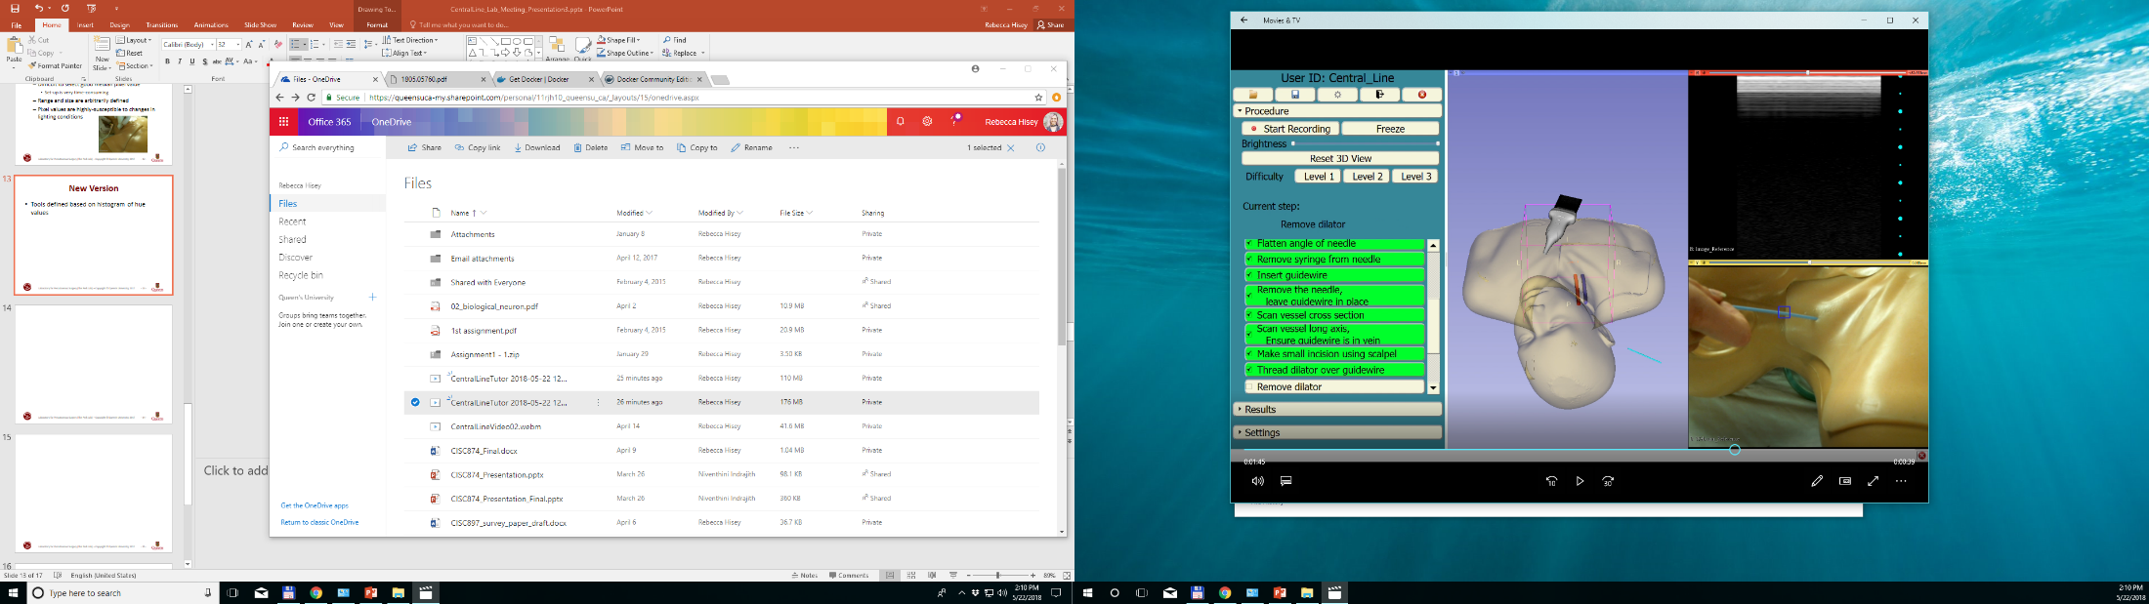
Background
Instruction and Feedback for Trainees
Automated workflow detection
Previous Method
Tools defined based on histogram of hue values
Tools located by finding region with the most similar histogram
Notes:
The work I focus on now are based on the former work of Rebecca’s project Central Line Tutor. Since most of you have already known about that, here I will just made a quick review of the former work.
Central line tutor aims to provide instruction and feedback to trainees in real-time by using automated workflow detection. The previous tools identified method is based on the histogram of hue values and the tools are located by finding region with the most similar histogram.

Slide 3
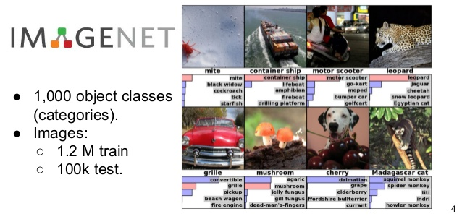
Improved Method
Improve tool detection by using deep learning
Train a convolutional neural network for image classification
Pre-developed network from ImageNet Challenge
Notes:
In order to achieve a better classification result, here we improve the former method by using deep learning.
We use a pre-developed network from ImageNet Challenge and retrain the image classifier model for the new categories.

Slide 4
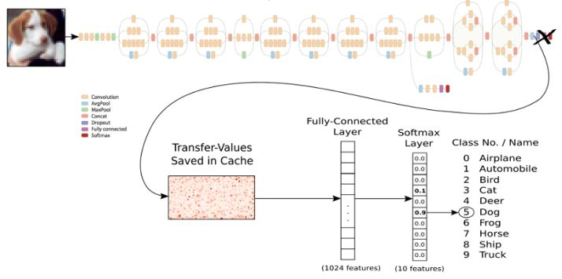
Transfer Learning
Fine tuning
Retrain the last layer of Inception V3 and identify the new classification
Notes:
Since modern image recognition models have millions of parameters, training them from scratch requires a lot of labeled training data and a lot of computing power (hundreds of GPU-hours or more). Transfer learning is a technique that shortcuts much of this by taking a piece of a model that has already been trained on a related task and reusing it in a new model.
Here we reuse the feature extraction capabilities from powerful image classifiers trained on ImageNet and simply train a new layer on top of inception v3.
Inception-v3 is trained for the ImageNet Large Visual Recognition Challenge using the data from 2012. This is a standard task in computer vision, where models try to classify entire images into 1000 classes, like “Zebra, "Dishwasher".

Slide 5
Work Flow
Data collection
Labeling
Retrain Classifier Model
Visualize the retrain with TensorBoard
Testing
Notes:
The work can be divided as 3 parts, Data collection and labeling, retrain classifier model and testing.
I will state the relevant work by turn below.

Slide 6
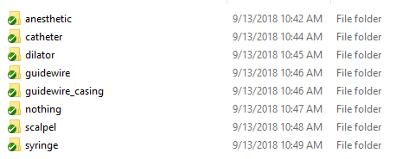
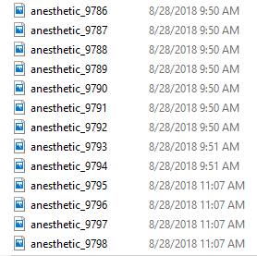
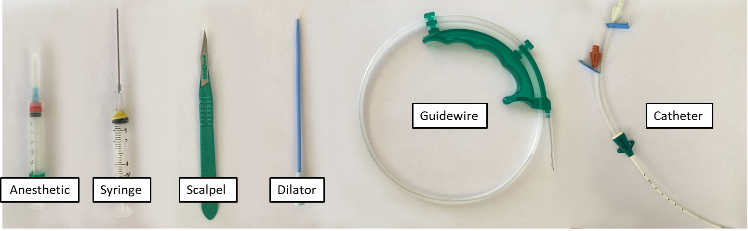
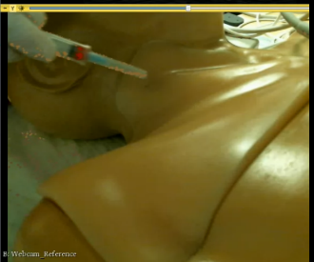
Data Collection and Labeling
Cut single frames from video
8 classes, about 10000 images per class
Notes:
Data collection and labeling is an easy, time consuming but very important part, since any deep learning task is inseparable from a variety of training samples.
Here we got 20 videos for the training samples. I wrote a script to split the video into single frames, save them as pictures and made tag on it. Finally, we got 8 classes and there are about 10k images per class.

Slide 7
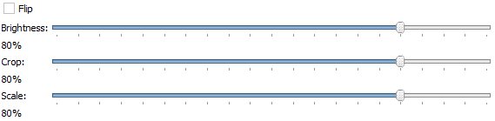
Retrain Experiment Idea
Distort to polish the model
Train the network with different parameters
Change one parameter at a time at 10% intervals, all others are set as zero
Hyper-parameters
learning_rate = 0.01, training_batch_size = 100,
training_steps = 12000
Notes:
Here comes the retrain part, which is the most important part in the work flow.
In order to improve the results of image training , we made deforming, cropping, or brightening in the training inputs in random ways. This has the advantage of expanding the effective size of the training data to all the possible variations of the same images, and tends to help the network learn to cope with all the distortions that will occur in real-life uses of the classifier.
We trained the network under different parameters to find the best model. These distortions are enabled by passing --random_crop, --random_scale and --random_brightness to the script. They are all percentage values that control how much of each distortion is applied to each image. We start with values of zero for each of them and then change one parameter at a time at 10% intervals, while all others are set as zero.
--flip will randomly mirror half of the images horizontally, which makes sense as long as those inversions are likely to happen in your application. For our application, it is reasonable that the medical instruments can be flipped. This parameter is enabled by passing –flip_left_right to the script.
For the hyper parameters settings, the --learning_rate is set as 0.01, which controls the magnitude of the updates to the final layer during training. Intuitively if this is smaller then the learning will take longer, but it can end up helping the overall precision.
The --train_batch_size is set as 100, which controls how many images are examined during each training step to estimate the updates to the final layer.
The –-training_steps default value is 4000, here we set it as 12k. The rate of improvement in the accuracy slows the longer we train for, and at some point it will stop or even go down due to overfitting, Actually we need experiment to see which value works best for our model.

Slide 8
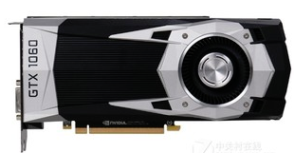
Environment Set Up
CUDA Toolkit 9.0
cuDNN v7.0.5 (Dec 5, 2017), for CUDA 9.0
Tensorflow GPU
Python 3
GPU NVIDIA GeForce GTX 950, 1060
Notes:
For the experiment environment, in order to use Tensorflow GPU, we need to set up CUDA and corresponding cuDNN first. I use both the computer on my desk and the shared computer in the equipment room for training the model. The GPU on them are GTX 950, 1060 respectively.

Slide 9
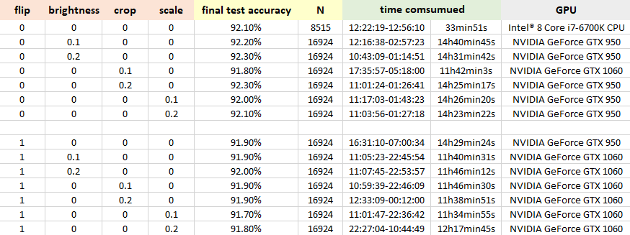
Retrain Result
Final test accuracy, N(length of bottleneck), and time consumed are collected
Notes:
This table shows the experiments we have run out now. They are far away enough for the final conclusion. The experiment will continue in the next days.
After each experiment, final test accuracy, length of bottleneck and time consumption are collected. The influence of each parameter are analyzed according to these information later.

Slide 10
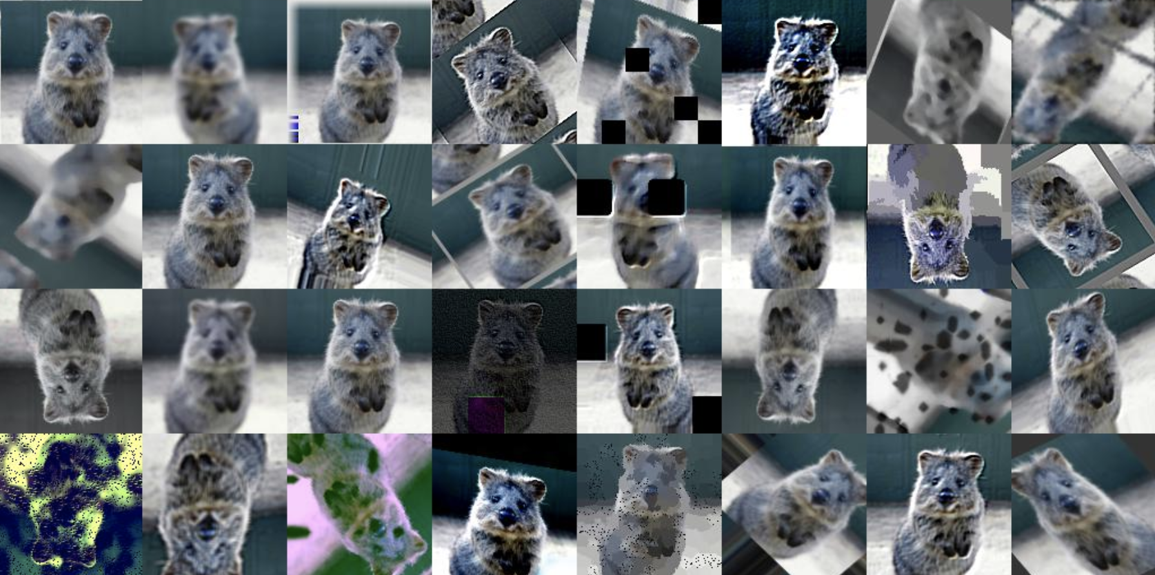
Parameters Influence
Brightness, crop, scale
Test accuracy improved as data diversity increased
The greater the value, the better the results
No much difference in time consumed
Notes:
From the experiment result, some conclusions about parameters influence can be drawn.
For brightness, crop and scale, the test accuracy shows improvement as data diversity increases, the greater the value, the better the results. There is no much difference in time consumed between different values of parameters.

Slide 11
Parameters Influence
Theoretically, the more diverse the data, the better the generalization of model
Flip
Contrary to the theory
Maybe due to the inadequate training for 12k steps
Data enhancements increase the number of pictures. Thus, flipped groups are not as fast in fitting as non-flip groups under equal steps(12k).
Need comparative experiment to verify the guess
Notes:
Theoretically, the more diverse the data, the better the generalization of model, that means groups flipped should be better than groups without flip and groups with brightness, crop, scale ≠ 0 should have better result.
While, for flip, what the experiment result shows is contrary to the theory. I guess that maybe this is due to inadequate training, since data enhancement increase the number of pictures. Thus, the flipped groups are not as fitting enough as non-flip groups under equal steps, which is 12k steps in our experiment. While this is only the current conjecture. It is necessary to increase the number of training steps and do some comparative experiment to verify our guess.

Slide 12
Time Consumption
Retrain time duration
When the parameters are all set as zero, the retrain duration is short (30 min on CPU).
cache bottleneck values on disk so they don't have to be repeatedly recalculated
The speed is greatly reduced when parameters are changed (10+ hours on GPU)
bottleneck caching is no longer useful, since input images are never reused exactly
No significant difference in training duration when the parameter value increases.
Notes:
For the time consumption, we can see that when the parameters are all set as zero, the retrain duration is short (30 min on CPU). While the retrain speed is greatly reduced when we made transform on the images. (10+ hours on GPU)
To explain the reason of these phenomenon, we first need to make clear of two points, what bottleneck is and how parameters can be saved for images when they are not transformed.
‘Bottleneck’ is an informal term we often use for the layer just before the final output layer that actually does the classification. (TensorFlow Hub calls this an “image feature vector”.) This layer has been trained to output a set of values that's good enough for the classifier to use to distinguish between all the classes it's been asked to recognize. Because every image is reused multiple times during training and calculating each bottleneck takes a significant amount of time, it speeds things up to cache these bottleneck values on disk so they don't have to be repeatedly recalculated.
So why it take so much longer if we made transform on the images? This is because that enabling these distortions in our script made the bottleneck caching no longer useful, since input images are never reused exactly. This means the training process will take a lot longer (many hours). That’s why we changed to GPU after the first attempt on CPU.
Once any distortion is applied, there is no significant difference in training duration when the value of a specific parameter changes.

Slide 13
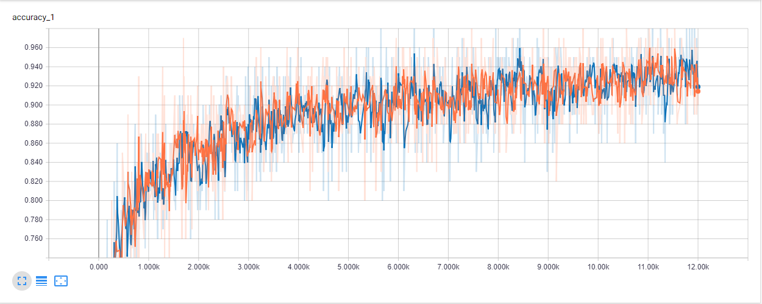
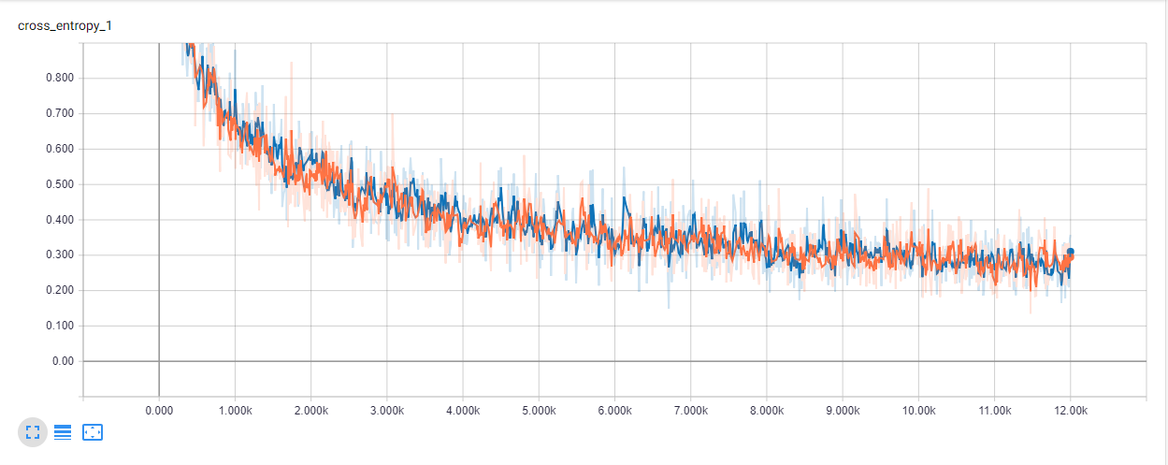
TensorBoard
The convergence speed is not much different under different parameter settings.
Accuracy
Cross_entropy
Notes:
From TensorBoard, we can compare the accuracy and cross_entropy graphs of different experiments, we can see that there is no significant difference in the curve trend. That is to say, the convergence speed shows not significant difference under different parameter settings. The general trend of accuracy is gradually rising, then tending to be gentle after 11k steps.

Slide 14
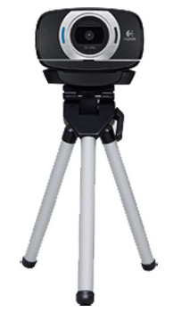
Future Work
Continue current experiment to find the best parameters settings
Use the retrained model for classification testing
Notes:
For the following work, the current experiment will continue as planed. When the best retrained model is found, we will use it for testing in real time web-camera video.

Slide 15
Outside the project : )
Notes:
Yeah, Above is my introduction to my project.
Outside the project, I also want to share something with you~
I am very happy for two months at perk Lab and feel the friendliness and warmth from everyone in perk lab. I have become familiar with Kingston and Queen‘s University with the help of you. I have thought for a while what I can share with you and I finally choose my university city and my university, which are I am most familiar with. Hope you can have a glance from my pictures~

Slide 16
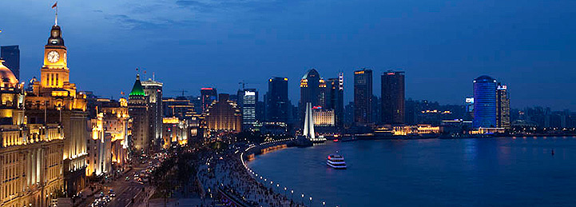
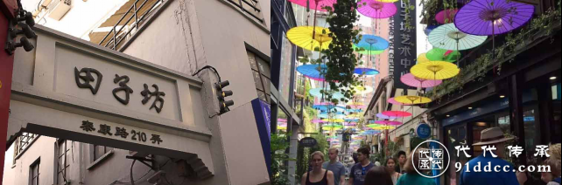
Shanghai
Some places of interest
The bund
Tianzi Fang
Notes:
Let’s see Shanghai first
Shanghai is one of the most biggest cities in China, it is amazing, crowded, combined with both modern and ancient elements. If some of you plan to visit it someday in the future, you can feel free to ask me anytime for more detailed information or any kind of help, I will be very very glad to help.
The first site I want to introduce is the Bund. It is a waterfront area in central Shanghai, which usually refers to the buildings and wharves on this section of the road. It is one of the most famous tourist destinations in Shanghai. For most people traveling to Shanghai, the Bund is their first stop.
Next comes TianZi Fang. It is a touristic arts and crafts place that has developed from a renovated traditional residential area. Tianzi Fang is known for small craft stores, coffee shops, trendy art studios and narrow alleys. Tianzi Fang is largely hidden from the neighbouring streets, as it grew from the inside of the block outward. When I first went there 3 years ago, the most district impression on me is that the alley is so narrow, at some of the points you can’t pass if there are more than 4 persons side by side.

Slide 17
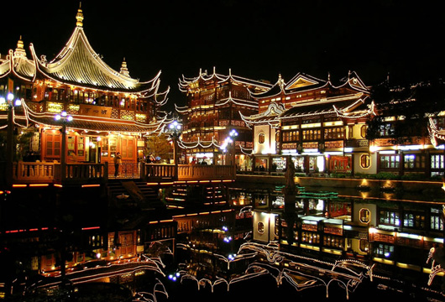
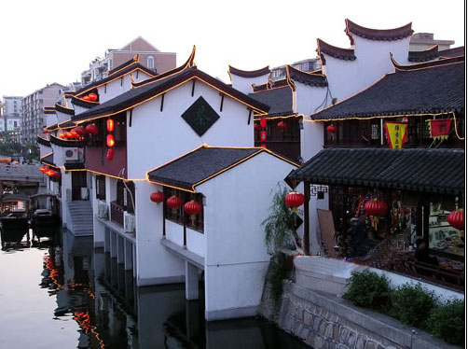
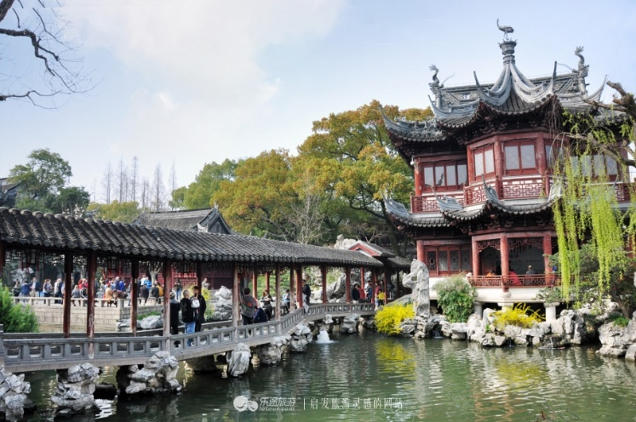
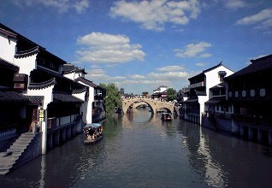
Shanghai
Yu Garden
Qibao Old Town
Notes:
And here are another two similar sites, Yu Garden and Qibao Old Town. Both of them are characterized by ancient Chinese architecture.
Yu Garden is an extensive Chinese garden located beside the City God Temple in the northeast of of Shanghai.
This site is very close to my university, I think about 5 stops by subway. It is especially beautiful at night, when the lights are lit up, and there are a lot of traditional Shanghai snacks sold in the street.
The site on the right is the Qibao Old Town, which is a tourist attraction, with traditional Chinese architecture and a number of museums and street food. The area was once the residence of the painter and sculptor, and I thought there are still some residence living there now.

Slide 18
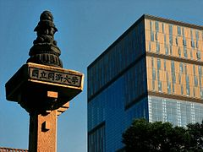
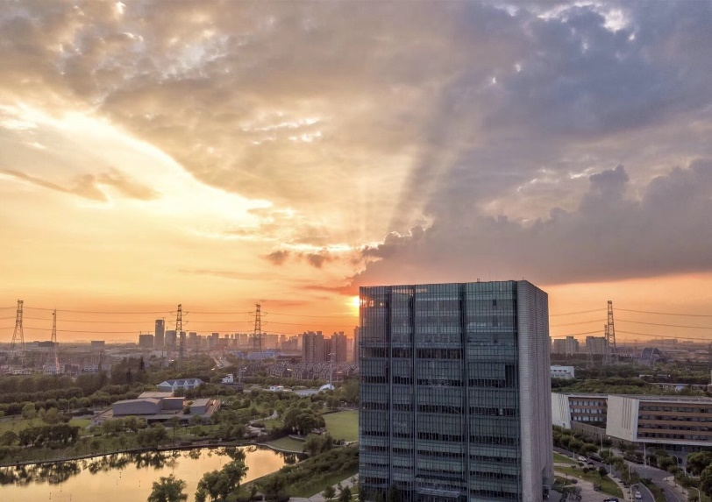
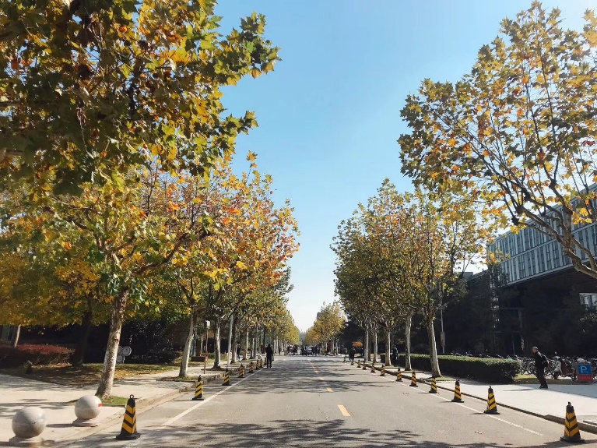
My University
Tongji University
Established in 1907
One of the oldest and most prestigious universities in China
Notes:
And some more on my university, Tongji University. Which is established in 1907 and one of the oldest and most prestigious universities in China. It is It has four campus and I stay in the main campus in the freshman year and the fourth year, and another campus in Jiading District for my sophomore year and the third year.
The picture on the right is the national column set up when the school is established. The characters on it means Nation Established Tongji University
And the bottom left picture is the library in Jiading Campus, I really like it because it has 14 floors so there are always seats available and I don’t need to get up early just for occupying a seat there. The one on the right is the road to my department, School of Software Engineering. Most of the time, I rode a bike between the dormitory, the classroom and the school lab.

Slide 19
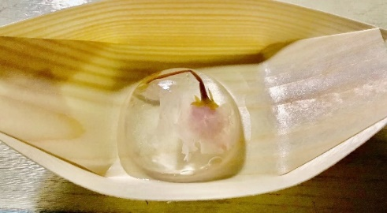
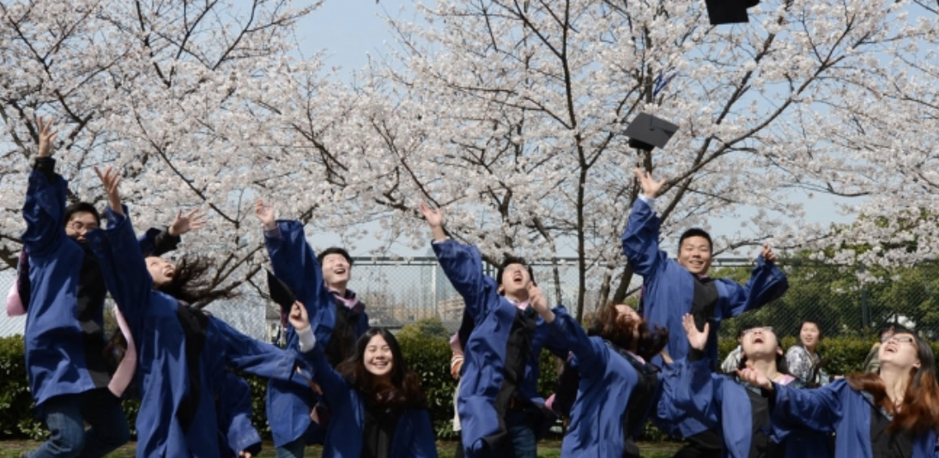

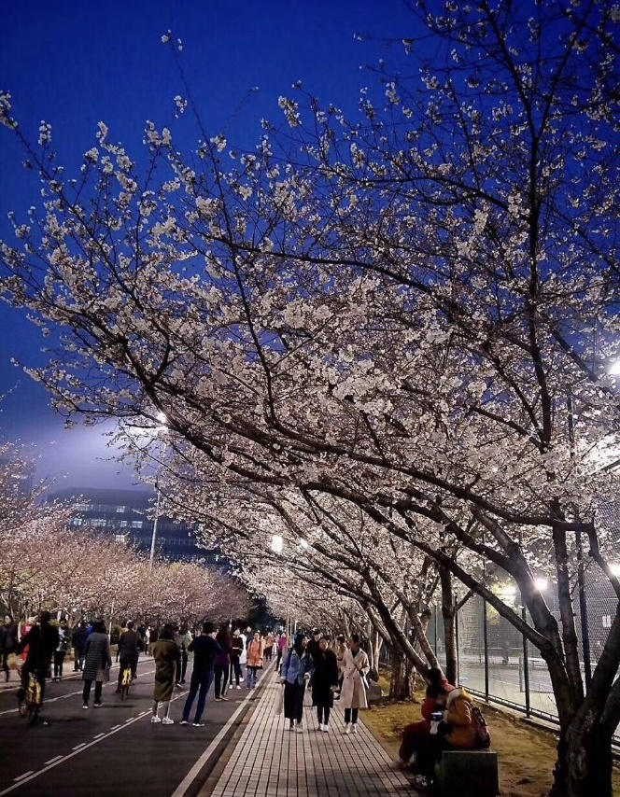
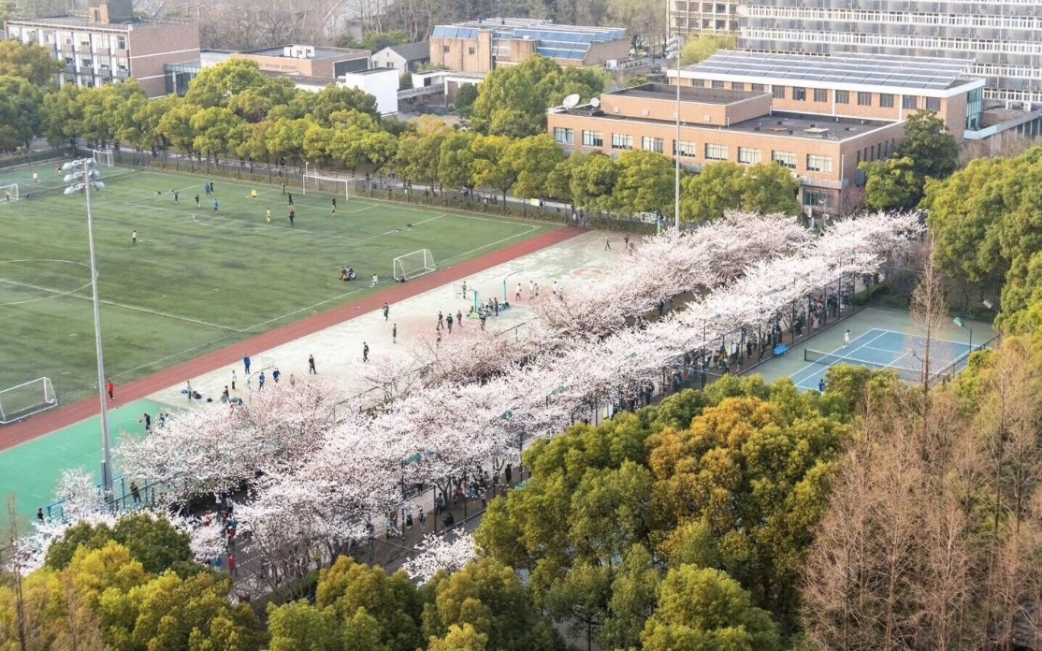
My University
The Cherry Avenue
Notes:
And here comes a famous road in my university among Shanghai residence. The Sakura road is a landscape that Japanese friends gave Tongji University the trees to plant on Sakura Avenue to promote the friendship and cooperation between Tongji University and Japanese.
The road is fully planted with cheery and when the flowers blossom in March or May, which is just in the graduation season of each year, the road will be crowed with so many people taking photos. At that time, there will be a series of activities held by Tongji University Student Union, attracting tourists from all over Shanghai come to visit.
This picture on the right is photographed by my friend, you can see that the cherry is dream like beautiful in the night, half-cover by the light.

Slide 20
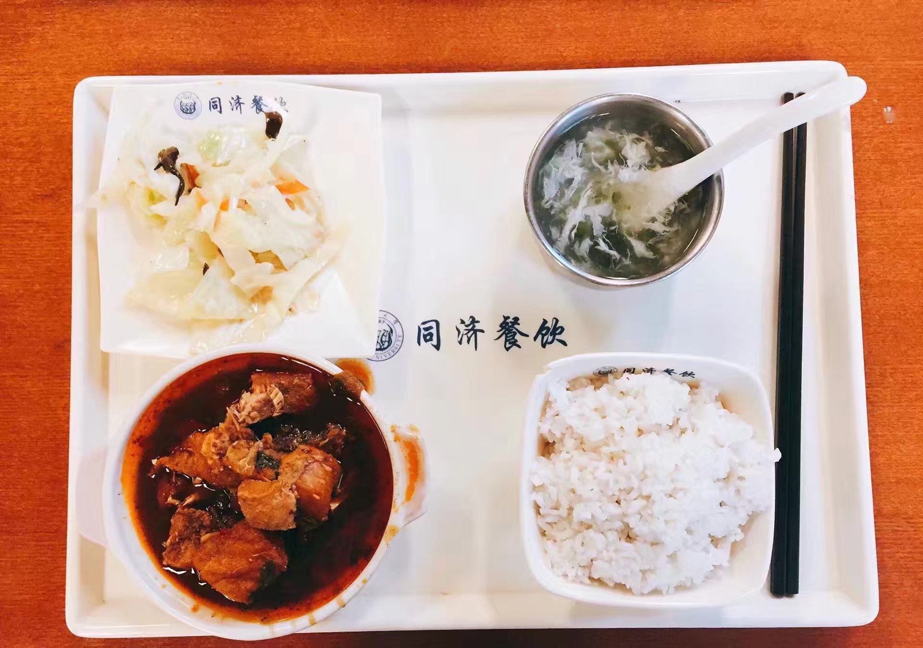
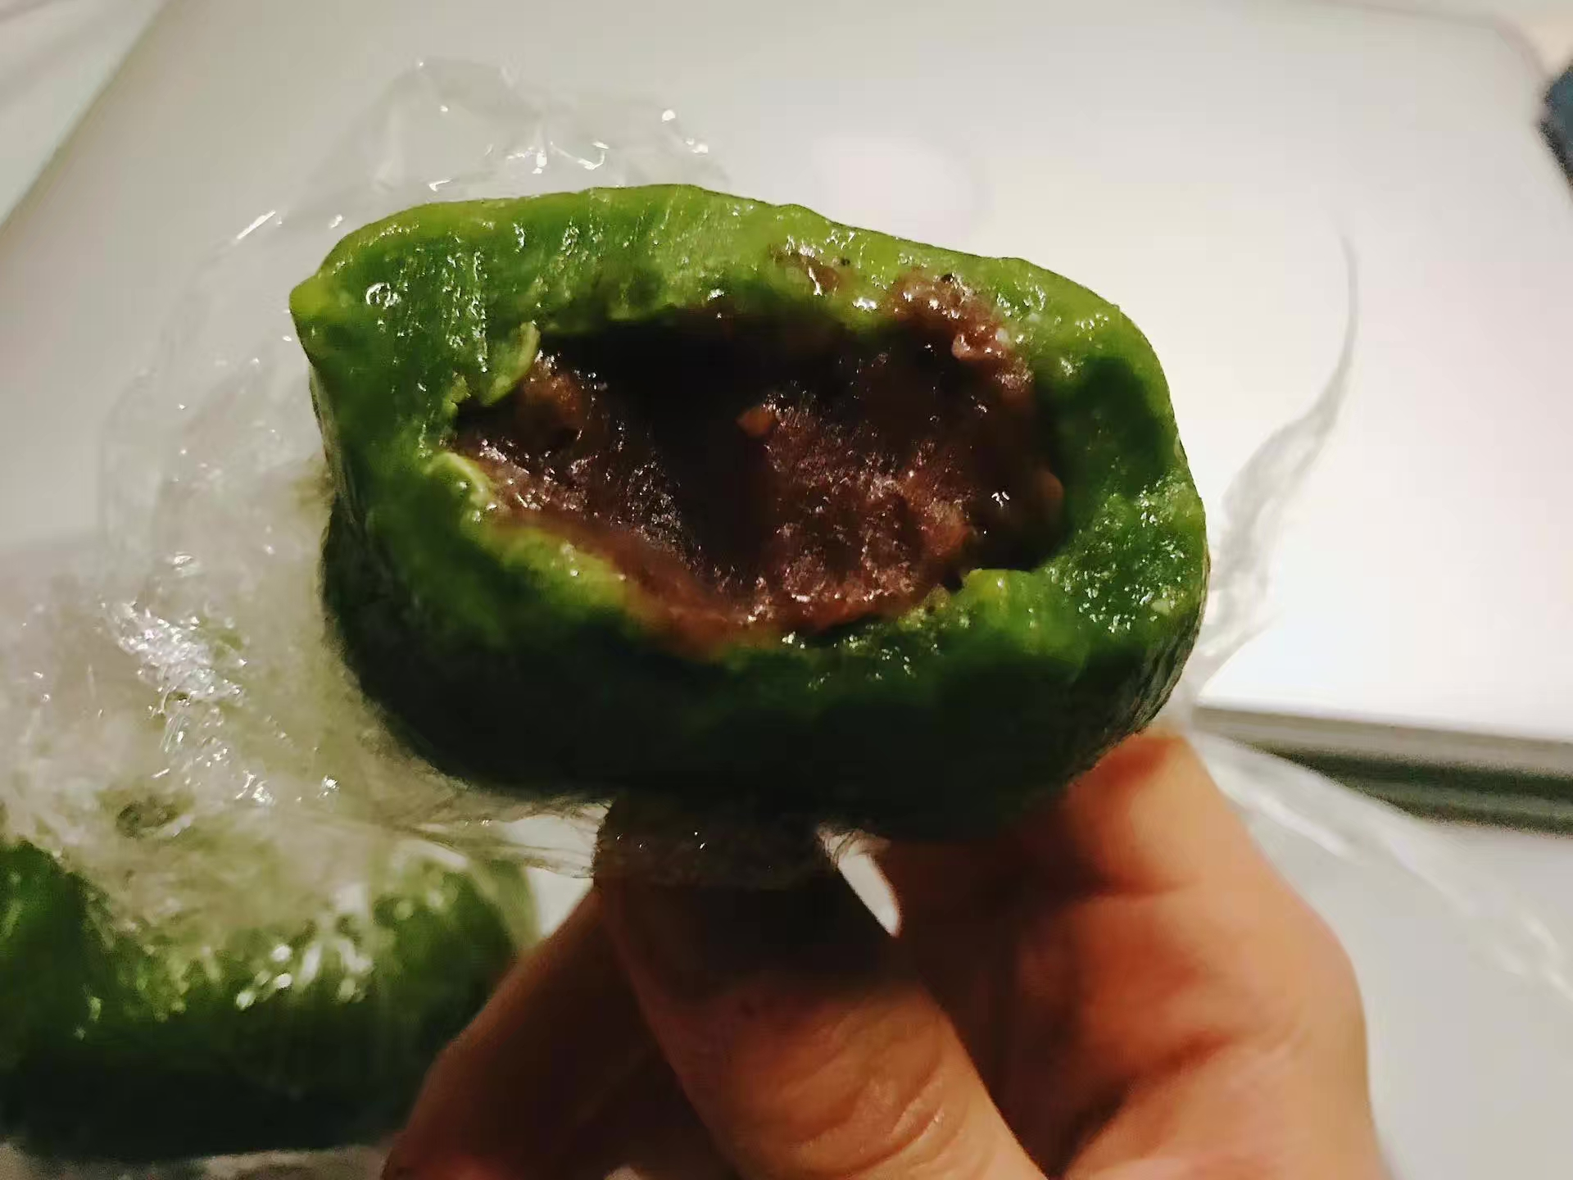
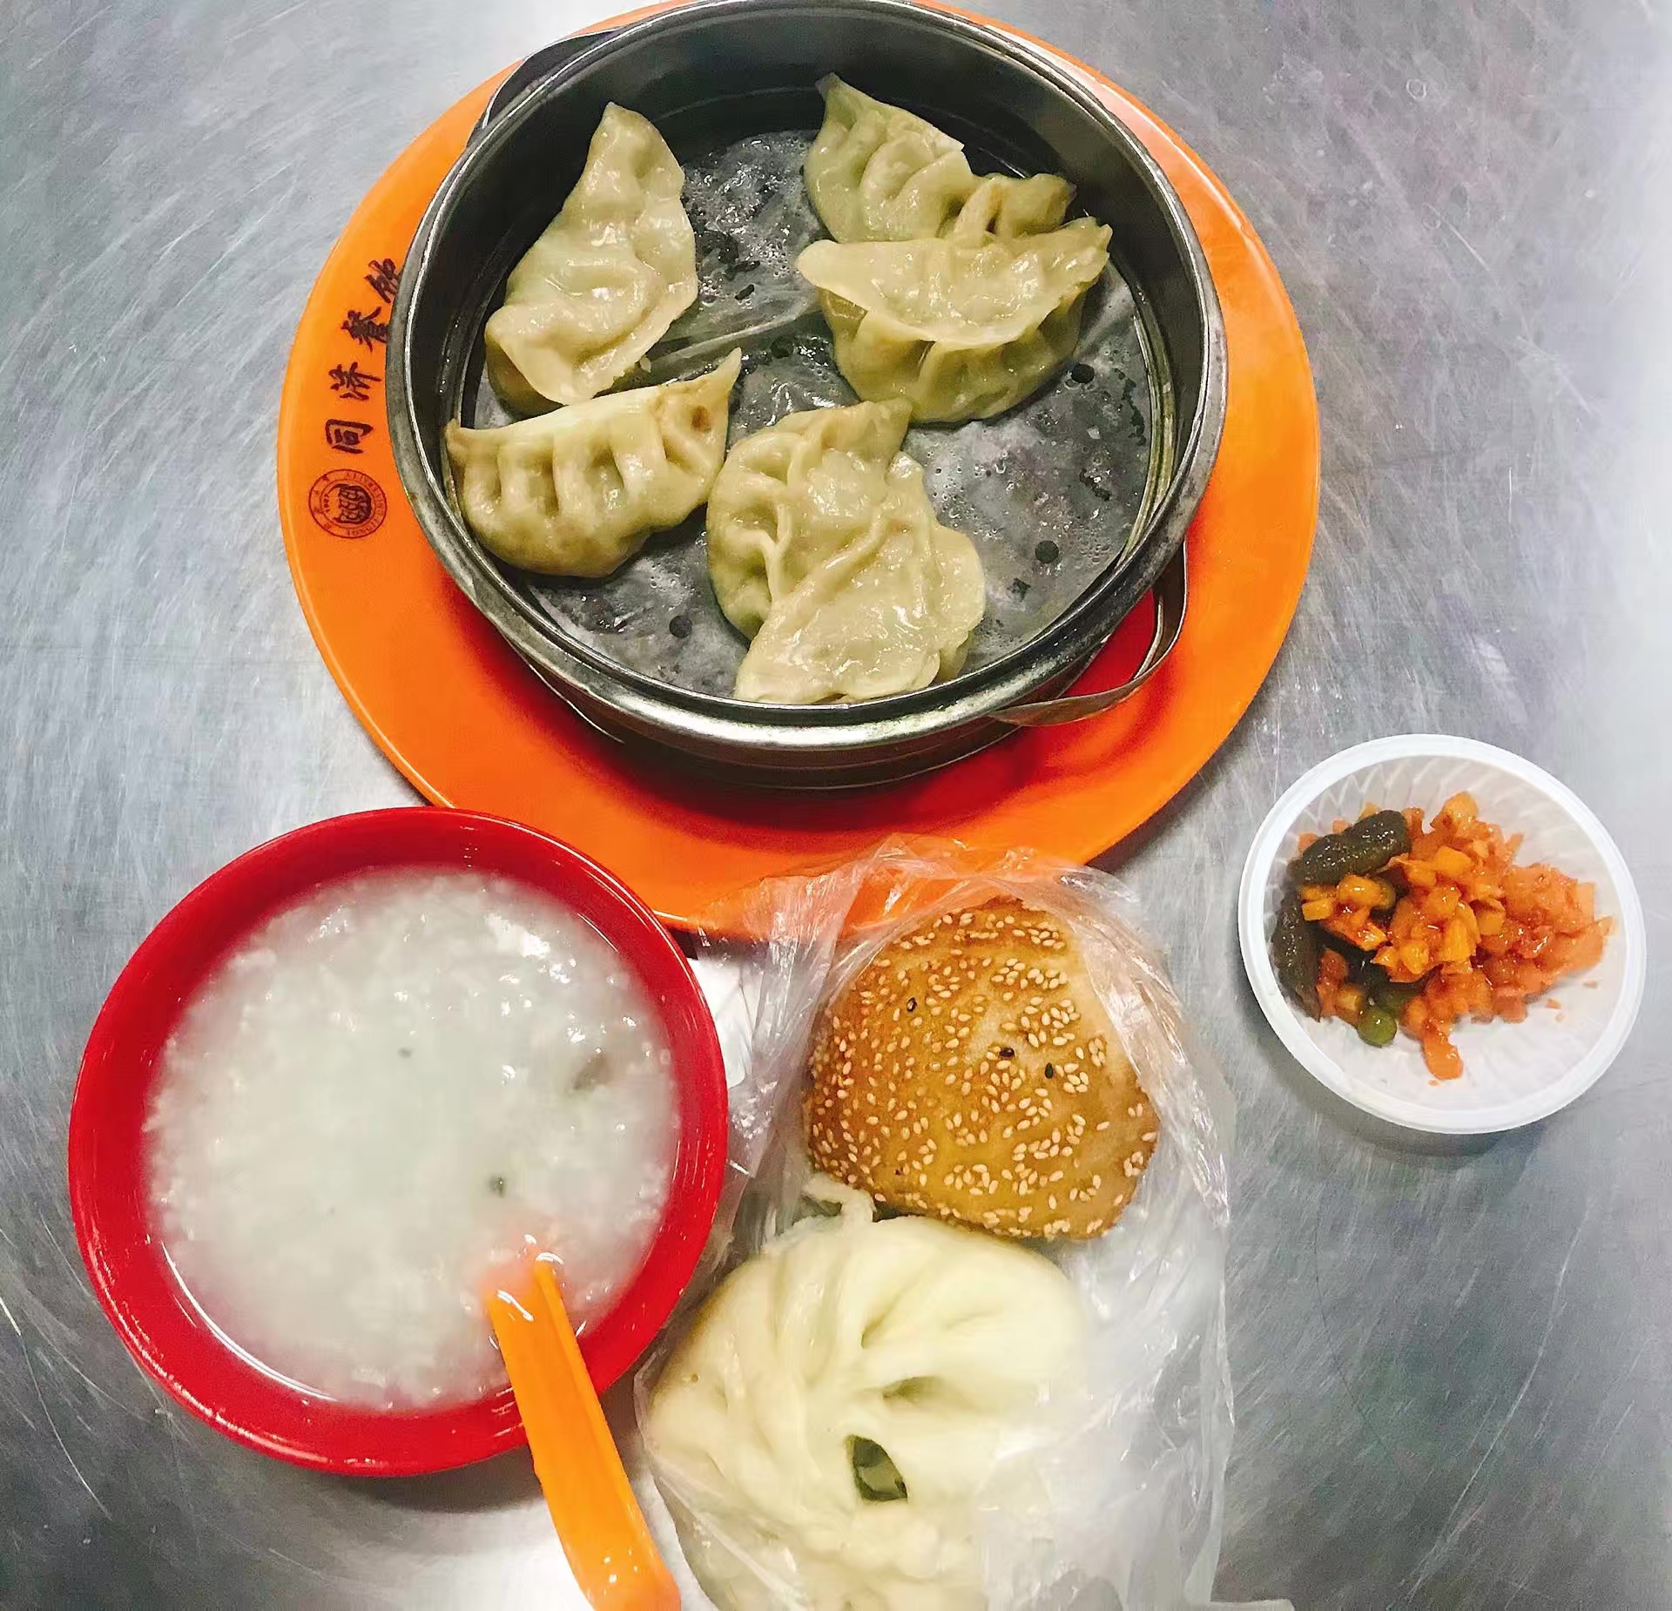
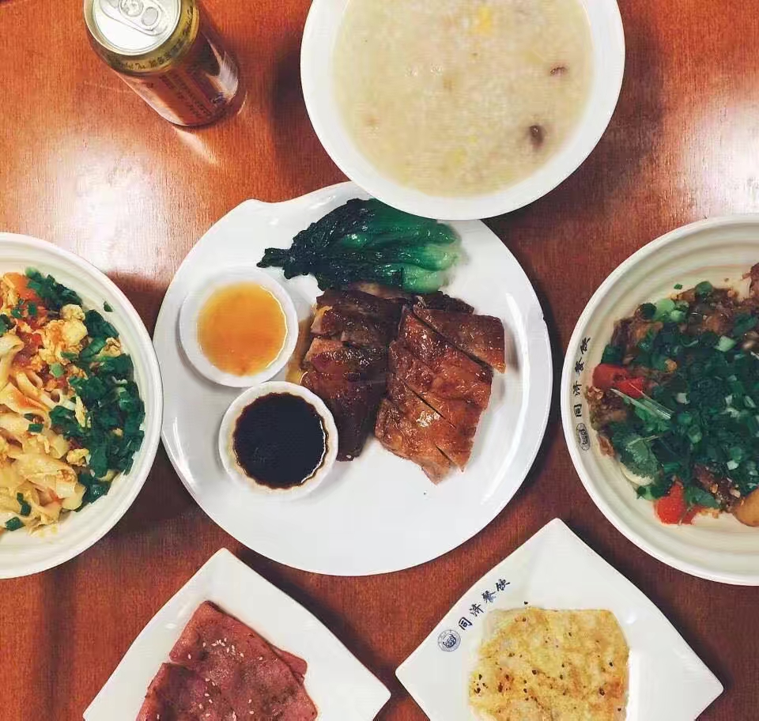
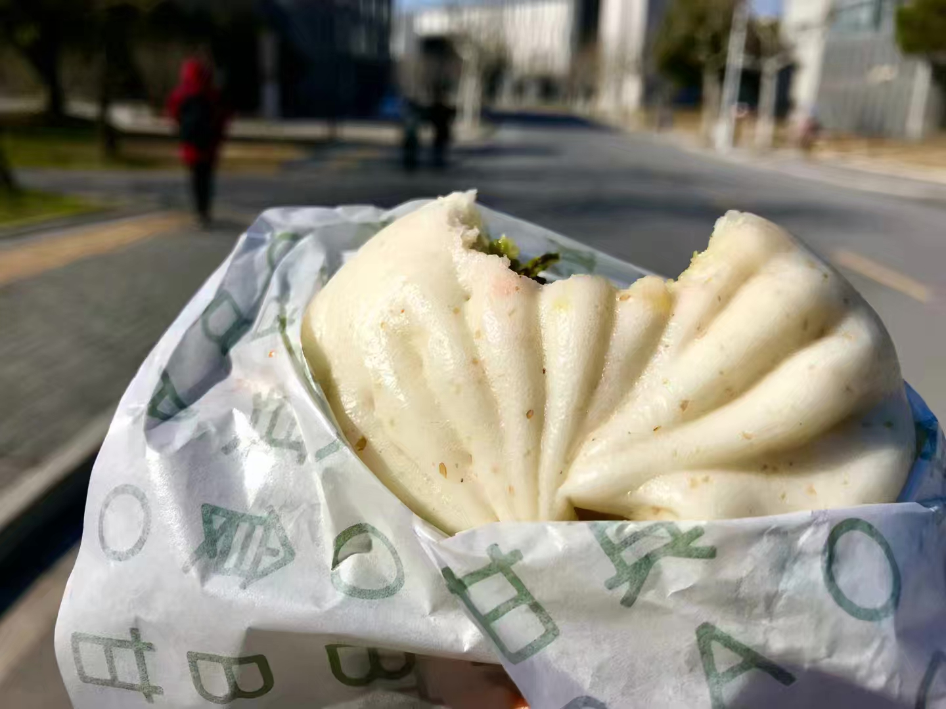
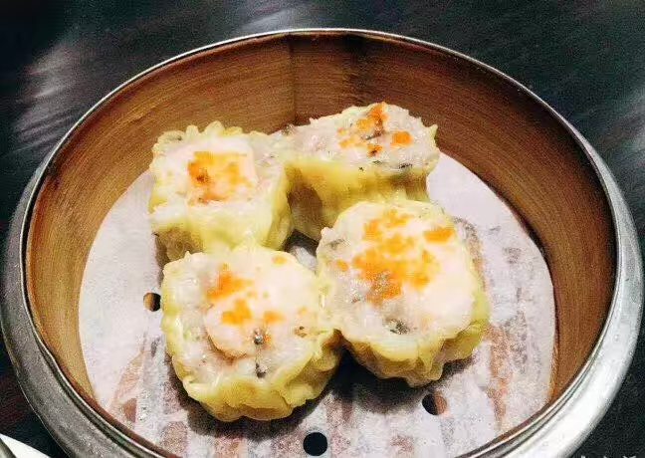
Food in Tongji
Notes:
These are the things I eat everyday in China. Some of them are very local in Shanghai. Like the Green Dumplings in the middle. It is a traditional snack made by glutinous rice flour and sweetened bean paste. I really like them for the fragrant of grass and flavor of sweetness : )
If any of you will visit Shanghai one day in the future, I will be very glad to introduce more snacks worth trying in details~
Yeah, that's all I have prepared for a simple introduction of my life in China.
I really enjoy the days here in perk lab and I will be back on October 16th. I'm sure I will miss you when I come back to China and looking forward to see you in the future!

Slide 21

Questions?
Thanks to directions from
Rebecca Hisey, Tamas Ungi, Andras Lasso

